Slide 1
DEPLOYING WINDOWS SERVER REMOTE ACCESS-VPN
Lecturer: Trần Thị Dung
Trần Phúc Hoàng Duy – 21522011
Lý Thế Nguyên – 21522389
Lê Triệu Vỉ - 21522785
1

Slide 2
Contents
01
02
03
04
General information
Component
Operation
Implementation and Result
2

Slide 3
01
General information
3

Slide 4
Overview
- VPN stands for “Virtual Private Network” and describes the opportunity to establish a protected network connection when using public networks. VPNs encrypt our internet traffic and disguise our online identity.
4

Slide 5
Types of VPN
Remote Access VPN
Site-to-Site VPN
Client-to-Site VPN
5

Slide 6
VPN Protocols
OpenVPN
IPSec (Internet Protocol Security)
L2TP/IPSec (Layer 2 Tunneling Protocol with Ipsec)
PPTP (Point-to-Point Tunneling Protocol)
SSTP (Secure Socket Tunneling Protocol)
IKEv2 (Internet Key Exchange Version 2)
6

Slide 7
02
Component
7

Slide 8
Server-side components
VPN Server
Server Operating System
Static IP or DNS
8

Slide 9
Server-side components
Authentication and User Management
VPN Protocol Configuration
Firewall and Network Rules
9

Slide 10
Client-side components
Client Device
Client Operating System
VPN Client Software
10

Slide 11
Client-side components
VPN Configuration Settings
Network Connection
Firewall Rules
11

Slide 12
03
Operation
12

Slide 13
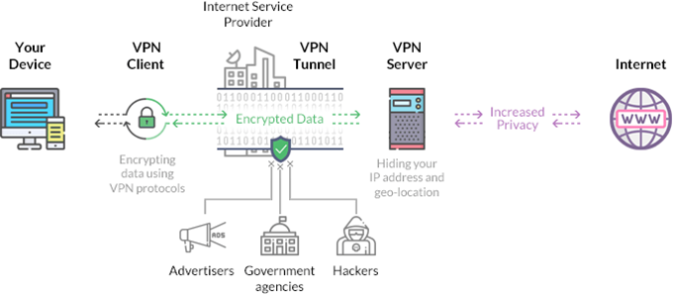
13

Slide 14
04
Implementation and Result
14

Slide 15
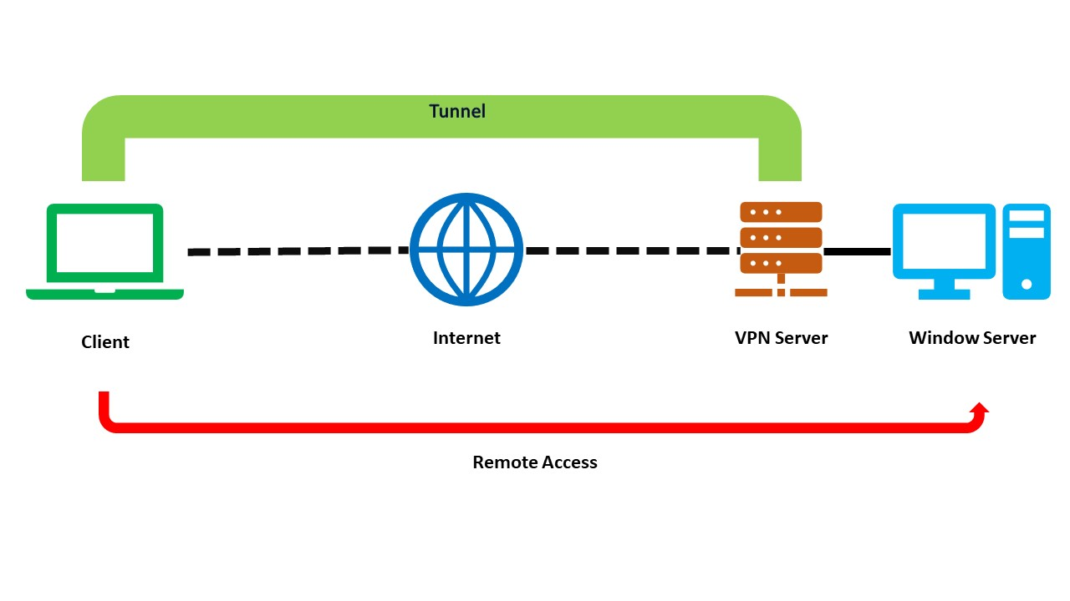
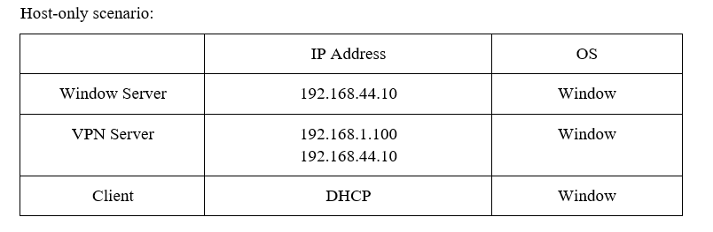
TOPOLOGY
15

Slide 16
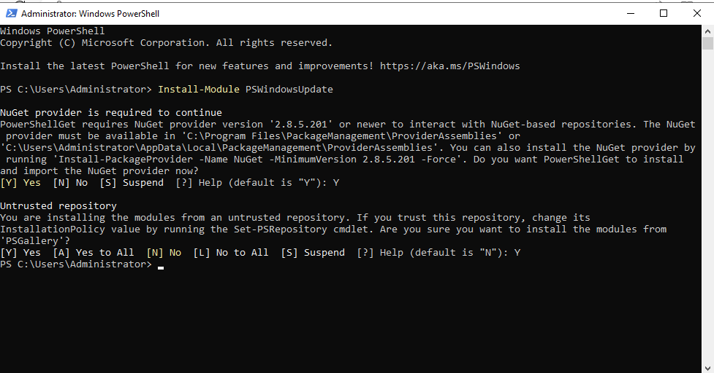
INSTALLATION
Update Windows Server
Open Windows Powershell as Administrator and Enter “Install-Module PSWindowsUpdate” to update module for Powershell.
16

Slide 17
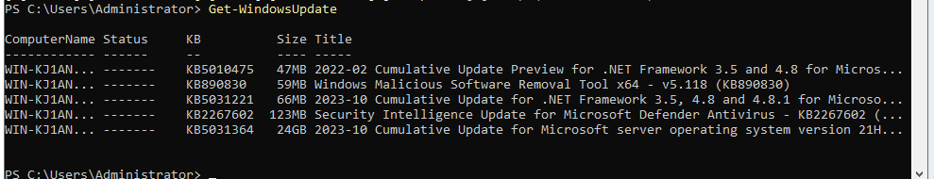
INSTALLATION
Update Windows Server
Enter “Get-WindowsUpdate” to get the list of the latest updates.
Finally, install the latest updates by running “Install-WindowsUpdate”.
Restart the system by entering the following command “Restart-Computer”.
17

Slide 18
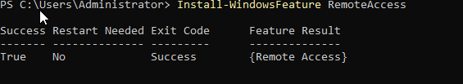
INSTALLATION
Install Remote Access Role in Our Windows Server 2022
Open Windows Poourshell as Administrator and install the following:
Remote Access feature: “Install-WindowsFeature RemoteAccess”.
18

Slide 19
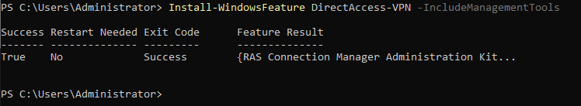
INSTALLATION
Install Remote Access Role in Our Windows Server 2022
Direct Access and VPN (RAS): “Install-WindowsFeature Direct Access-VPN -IncludeManagementTools”.
19

Slide 20
INSTALLATION
Install Remote Access Role in Our Windows Server 2022
Routing along with management tools: “Install-WindowsFeature Routing -IncludeManagementTools”.
20

Slide 21
